Slide 1

Project August
Including RxClaim Agile Change Management Initiative
March 30, 2018

Slide 2
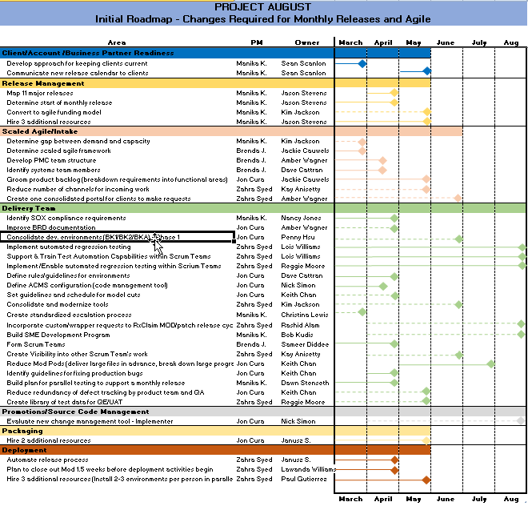
Initial Roadmap – Changes Required for Monthly Releases and Agile

Slide 3
Last Updated 03 30 2018
Status:
RxClaim Agile Transformation Change Management
Weekly Status Report
Status | G | Y | R | C | D
 | On Track | At Risk | Missed | Complete | Dependency / TBD
Key Milestones for RxClaim Product Agile Transformation
Milestone | Owners | Date | % Complete | Status | Comments
Hold Kickoff | B. Johansen | 01/23/18 | 100% | C | Complete
People
Determine Product Breakout | J. Cauwels | 04/09/18 | 75% | G
Identify Product Owners | Cauwels & Wagner | 04/23/18 | 0%
Establish Scrum Teams | Kudis & Diddee | 04/1218 | 10% | Y | Dependent upon demand data
Business Engagement | H. Aquino | 04/15/18 | 30% | G | for Product Structure
Process
Finalize Intake / PMC | J. Cauwels | 05/01/18 | 50% | G
Determine Code Change Mgmt / Synon Model / Environment Mgmt | K. Chan & D. Cattran | 05/30/18 | 25% | G | MODPODs, large objects
Insure SOX Compliance | K. Jackson | 04/30/18 | 50% | G
Determine Release Schedule (Monthly, major) | K. Jackson | 06/01/18 | 35% | G | Ties to Project August
Tools
Implement QE Automation | R. Moore | 07/31/18 | 35%
Integrate SN with Rally | K. Jackson | TBD | 0% |  | Pilot being considered
YELLOW Status and Get to Green
YELLOW due to
YELLOW due to no dedicated Agile coach assigned; Resources not attending/participating in scheduled meetings which is pushing out our schedule
Get to Green:
Request and receive a dedicated coach to guide us through our planning and decision making
Communicate risk to schedule to senior leadership for prioritization and communication back to resources
Progress This Period
Progressed gathering demand data for Commercial for 8.3.07,8.3.08, 8.4.00 MODs
Progressed identifying 3 potential Agile roles for each applicable resource
Performed walk thru of 3 projects thru Scaled Agile Intake process
Finalized modeling Intake / PMC process, including resources/roles
Progressed with planning for monthly releases & SOX Compliance
Progressed discussions on Synon/Environments
Socialized concepts being considered for Agile transformation
Planned for Next Period
Request full time Agile Coach for RxClaim Transformation
Review Draft of Scaled and Non Scaled (work orders) Intake process with Operating Committee
Review draft of development cycle/ environment cycle
Refine list of resources for Release Mgmt work stream
Review strategy slide of RxClaim Tool Landscape with Operating Committee
Finalize # of Scrum Teams
Finalize estimate for effort on Agile Transformation and report to senior leadership

Slide 4
IRAAD – Dependencies & Impacted Work Streams
Dependency | Impacted Work Stream | Need | Date Identified | Owner | Notes
Categorization of annual demand | # of Agile Teams | Determine # of scrum teams per categorization | 01/23/18 | Jackie Cauwels
Categorization of annual demand | Agile Framework | Confirm Framework | 01/23/18 | Jackie Cauwels
Determine # of scrum teams per categorization | # of Agile Teams | Assign resources to scrum teams | 01/23/18 | B Kudis / S Diddee
Finalize Agile Team Framework | # of Agile Teams | Assign resources to scrum teams | 02/14/18 | Jackie Cauwels
Finalize Agile Team Framework | Synon/Environment Work Stream | Determine environment/library structures & assignments | 02/22/18 | Jackie Cauwels
Release Schedule | Environment Work Stream | Determine code change management | 02/22/18 | Kim Jackson

Slide 5
IRAAD – Issues & Risks
Issue or Risk | Date Identified | Owner | Description | Target Resolution Date | Get to Green | Notes
R1 | 2/21/18 | Bob Kudis Sameer Diddee | Resources unable to attend scheduled meetings due to higher priority responsibilities |  | Rescheduling meetings to accommodate schedules; monitoring our program schedule for impacts
R2 | 02/23/18 | Bob Kudis | Need resources to support roles with the scrum teams | Dependency on Agile Framework and Agile Teams work streams | Obtain output from Agile Framework (Product Breakouts) and Agile Teams (# of scrum teams, resource assignment) Work Streams and validate the risk or change the risk to an issue
R3 | 03/16/18 | Bob Kudis | Need dedicated Agile Coach to guide us through our planning and decision making | 04/15/18 | Request and receive a dedicate Agile Coach | Bob requesting

Slide 6
IRAAD – Action Items
Action Item | Date Identified | Owner | Target Resolution Date | Status / Notes
Determine interim process for BRD | 2/28/18 | Hazel Aquino | 3/16/18 | Meeting week of 4/02
Interview downstream application owners to obtain pain points | 2/28/18 | Hazel Aquino | 3/16/18
Determine to process to have funding approved prior to coming to Product Owner | 02/28/18 | Jackie Cauwels |  | In draft form

Slide 7
IRAAD – Assumptions
Assumption | Date Identified | Owner | Target Confirmation Date | Notes
Systems Team is Dave Cattran’ s Team | 02/01/18
Release Train Engineers are Release Team (Jason Stevens’ Team) and IT PM Team | 02/01/18 |  |  | Discussions in process
Product Management Council is Commercial (K Kettlewell), Gov’t (D Davis), Business (E Sookswat), Business Stakeholders/Requestors, Technical Product Team, Product Owners | 02/01/18
PMC will identify ancillary impacted applications | 02/01/18
Agile Teams (# of Scrum Teams, Resource Assignments) work stream dependent upon Agile Team Framework output | 02/19/18 | Jackie
Agile Teams (# of Scrum Teams, Resource Assignments) work stream dependent upon data of last 6 releases demand per TPM structure | 02/19/18 | Jackie

Slide 8
IRAAD – Assumptions
Assumption | Date Identified | Owner | Target Confirmation Date | Notes
Kettlewell and Davis will delegate decisions to BAs as Product Owners | 01/23/18 | Amber Wagner
Skills sets for each role will be used to determine role assignments | 02/01/18 | Resource Mgrs
Can have multiple teams for certain functional areas | 02/01/18 | Bob Kudis/Sameer Diddee
Some Developers can also cover SA duties | 02/01/18 | Dev Resource Mgrs
Product Manager is Christina Lewis | 02/01/18 | Christina Lewis
Teams might be aligned differently than they are today | 01/30/18 | Resource Mgrs

Slide 9
IRAAD – Assumptions
Assumption | Date Identified | Owner | Target Confirmation Date | Notes
Agile documentation is SOX compliant | 01/30/18
RTEs own coordination across Delivery Teams – similar to Cross App PMs | 02/01/18
Coaches need to be included in estimates for time charging | 01/23/18
Reduce Mod Pods by allowing large files to deploy before logic changes | 03/05/18 | Core Team | 03/09/18
Reduce Mod Pods by breaking down large programs | 03/05/18 | Core Team | 03/09/18

Slide 10
IRAAD – Decisions
Decision | Date Identified | Resources Agreed | Notes
Demand vs Capacity to be included in Project August | 02/13/18 | Amber, Dave, Hazel, Keith, Shweta, Sathya, Bob
Agile role assignments will be made by managers on the Agile Teams work stream | 02/19/18 | Bob, Reggie, Amber
Need development representation in the Environments Mgmt/Platform Upgrades work stream. Move Julie from Synon to Env. | 03/02/18 | Dave, Sameer, Hazel, Shweta | Julie notified 3/2/18
Keep Synon model open for 2 months (2 release cycles) | 03/05/18 | Hazel, Keith, Becky, Julie, Janusz, Nick, Derek

Slide 11
Agile Change Management Communication Plan - Meetings
Stakeholder Group | Communication Category/Type | Objective | Frequency | Communicator | Status
Operating Committee | Weekly Status Meeting | Provide status updates to operating committee – progress to date, issues/risks, showstoppers | Weekly | Brenda Johansen | In Process Fri 10:00 – 11:00 PT
Agile Teams Framework (Product Breakouts) | Weekly Work Stream Team Meeting | Progress the efforts to completion | Weekly | Brenda Johansen | In Process Tues 11:00 – 12:00 PT
Agile Teams (# of scrum teams, resource assignments) | Weekly Work Stream Team Meeting | Progress the efforts to completion | Weekly | Brenda Johansen | In Process Mon 10:30-11:30 PT
Intake including PMC | Weekly Work Stream Team Meeting | Progress the efforts to completion | Weekly | Brenda Johansen | In Process Wed 11:00 -12:00 PT
Release Mgmt (Monthly Releases, Sox audits) | Weekly Work Stream Team Meeting | Progress the efforts to completion | Weekly | Manika Kosaraju | In Process Tues. 8:30 – 9:00 PT
Synon Model Governance/Code Change Mgmt | Weekly Work Stream Team Meeting | Progress the efforts to completion | Weekly | Jon Cura | In Process Wed. 10:30 – 11:00 PT
Environments Mgmt Platform Upgrades | Weekly Work Stream Team Meeting | Progress the efforts to completion | Weekly | Jon Cura | In Process Wed 10:00 – 10:30 PT
Intake (SN)/Delivery Mgmt (Rational) | Weekly Work Stream Team Meeting | Progress the efforts to completion | Weekly | Zahra Syed | In Process Mon 11:30 – 12:00 PT

Slide 12
RxClaim Agile Planning: Governance Approach
Executive Steering Committee
Dan Zerafa
IT Sponsor
Jim Park
IT Sponsor
Operating Committee
Bob Kudis& Sameer Diddee
IT Leads
Hazel Aquino
Agile Lead
Christina Lewis
Product
Dave Cattran
Technology
Kim Jackson
Portfolio Delivery
Amber Wagner
Business Analysis
Brenda J & Shweta K
Planning Support
Kate P/Sathya K
Agile SME
Core Team
PEOPLE
PROCESS
TOOLS
Agile Teams Framework
(Product Breakouts)
Agile Teams
(# of scrum teams, resource assignments)
Intake including PMC
Release Mgmt
(Monthly releases, SOX audits)
Synon Model Governance/
Code Change Mgmt
Environments Management/
Platform Upgrades
Intake (SN)/Delivery (Rally)/Defect Mgmt (Rational)
Brenda
Jackie C
Kim Jackson
Shweta Khanna
Amber Wagner
Brenda
Bob K/Sameer D
Reggie Moore
Amber Wagner
Jackie Cauwels
Brenda
Jackie C/Amber W
Kim Jackson
Tarek Abdou
Sean Scanlon
Sameer Diddee
Bob Kudis
Manika
Kim J
Dawn Stenseth
Jason Stevens
Carol Ambrose
Keith Chan
Bob Kudis
Sameer Diddee
Dave Cattran
Nancy Jones
Kate Pichelman
Jon
Keith C
Becky Gierut
Julie DeVito
Jason Stevens
Janusz Szcepaniak
Dave Cattran
Bob Kudis
Sameer Diddee
Jon
Dave C
Reggie Moore (QE Automation?)
Julie DeVito
Jason Stevens
Derek Brod
Rob Planica
Sameer Diddee
Zahra
Kim J
Erica Barczak
Reggie Moore
Jackie Cauwels
Amber Wagner
Sameer Diddee
Bob Kudis
Shweta Khanna

Slide 13
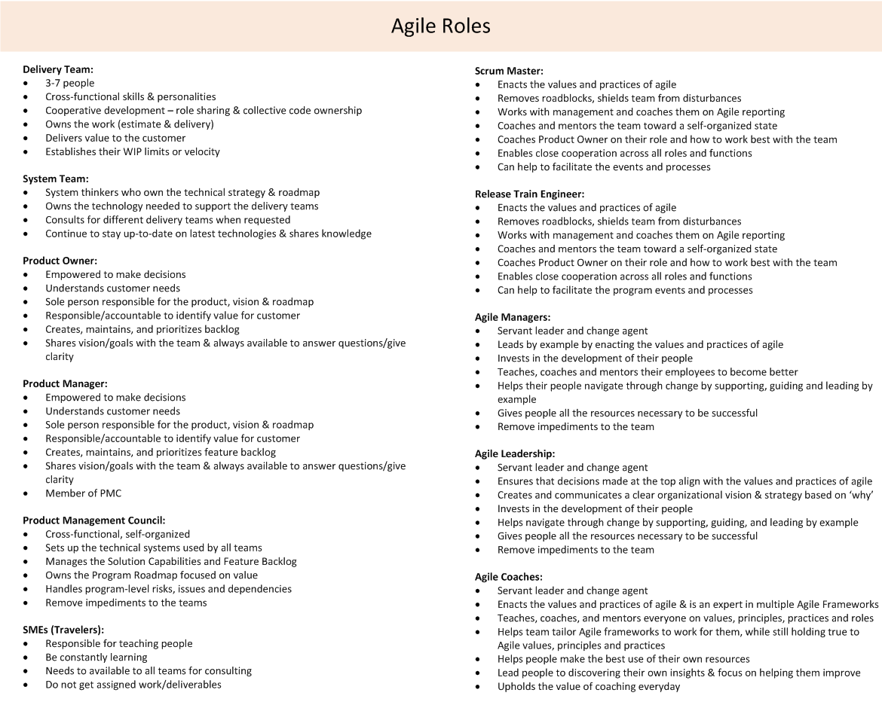
Agile Roles

Slide 14
Completed Action Items
Action Item | Date Identified | Owner | Target Resolution Date | Status / Notes
Provide count per dev area of Govt scope for 8.4.02 | 02/05/18 | Jackie Cauwels | TBD | Christine assisting
Discuss OptumRX SFGO Segmentation Hierarchy chart with Jim, then get back to Jackie | 02/06/18 | Kim Jackson
Apply Master List to OptumRx SFGO Segmentation Hierarchy chart, then further by application team | 02/06/18 | Jackie Cauwels
Have demand report pulled from Clarity | 02/06/18 | Shweta Khanna
Assign Product Designation on report from Clarity | 02/06/18 | Jackie Cauwels
Send Backlog to Shweta and Brenda | 02/06/18 | Engage SAs in process improvement activities | 2/28/18 | Hazel Aquino
Schedule 1 hr meeting with Kate re: RTE, interactions between PMC and Product Mgrs, Business Funding and Road Map | 02/23/18 | Brenda Johansen |  | Meeting scheduled for 03/05/18
Draft non-scaled intake process | 02/28/18 | Amber Wagner | 03/07/18

Slide 15
Completed Action Items
Action Item | Date Identified | Owner | Target Resolution Date | Status / Notes
Provide annual demand per product capability | 01/23/18 | Jackie Cauwels | 03/02/18 | Key dependency for multiple work streams
Receive OGS feedback on pain points | 2/28/18 | Manoj Gupta | 3/16/18 | DONE
Insure RxParallel resources engaged in Release Mgmt work streams | 3/02/18 | Dawn Stenseth | 3/16/18 | DONE

